Slide 1
Facebook Ads Campaigns

Slide 2
About A2Z Digital
At a2z-Digital™, we understand that you must rely on your digital agency as it the one of the most important part of your business.
We’ve been on a mission to revolutionize the international digital marketing industry since 2012.
Today, We provide personalized digital marketing solutions to many International businesses across the World.
We believe that you should love what you do, and we absolutely LOVE Digital marketing.
Along the years we achieved significant results for our customers that absolutely changed their business.
A2Z-DIGITAL.COM

Slide 3
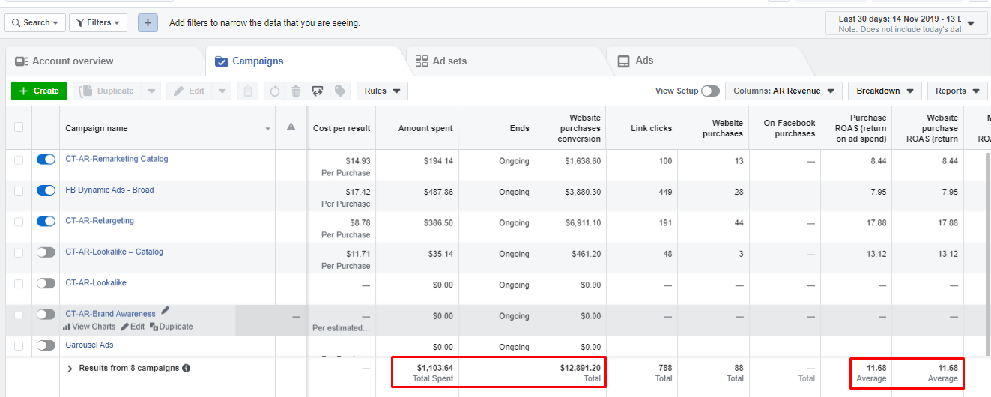

Slide 4
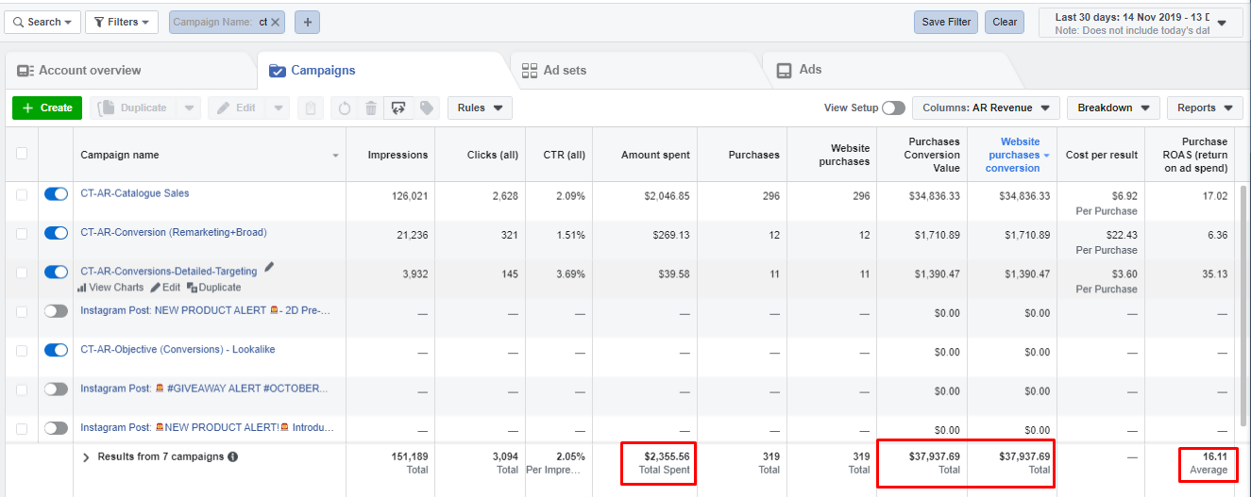

Slide 5
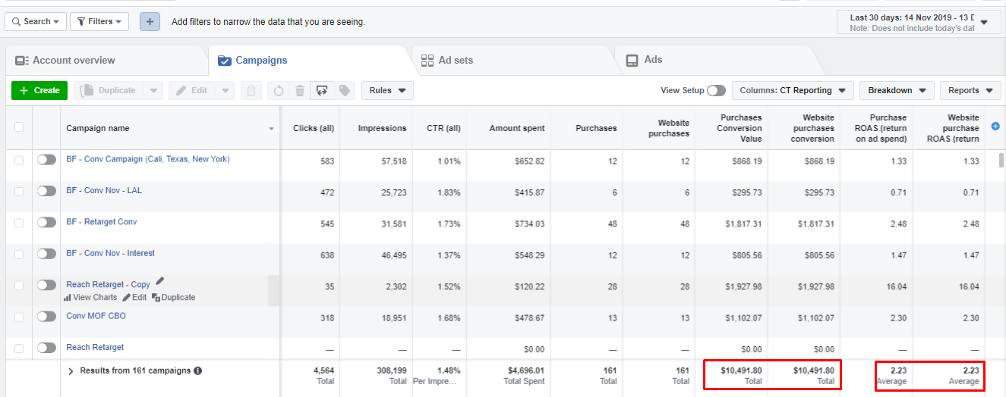

Slide 6
THANK YOU!

