Slide 1
SEM-AdWords-PPC Case Studies
www.a2z-digital.com

Slide 2
About A2Z Digital
At a2z-Digital™, we understand that you must rely on your digital agency as it the one of the most important part of your business.
We’ve been on a mission to revolutionize the international digital marketing industry since 2012.
Today, We provide personalized digital marketing solutions to many International businesses across the World.
We believe that you should love what you do, and we absolutely LOVE Digital marketing.
Along the years we achieved significant results for our customers that absolutely changed their business.

Slide 3
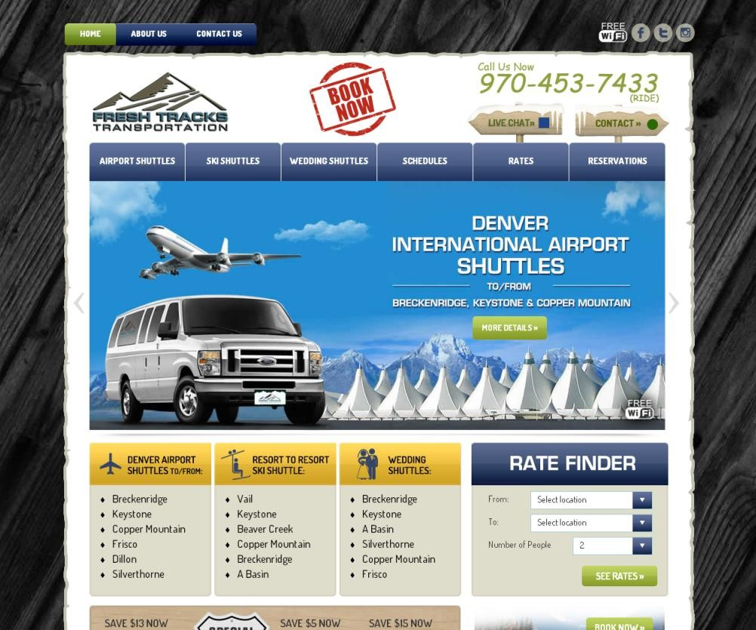
PPC Campaign – “Fresh tracks”
freshtrackstransportation.com
Clicks: | 759,244
Impressions | 69,520,109
CTR | 1.09%
Conversions | 13,098
Conv. Rate | 2.38%
Campaign Overview
SN | Campaign | Budget | Impressions | Clicks | CTR | Avg. CPC
1 | Remarketing | 50.00 | 1,29,886 | 1,723 | 1.33% | 0.14
2 | Display | 10.00 | 5,36,74,851 | 6,34,926 | 1.18% | 0.05
3 | Optimised Campaign 1 | 10.00 | 5,46,42,103 | 6,39,957 | 1.17% | 0.05
4 | Optimised Campaign 2 | 13.00 | 6,95,22,941 | 7,59,445 | 1.09% | 0.15
5 | Optimised Campaign 3 | 92.00 | 6,95,22,941 | 7,59,445 | 1.09% | 0.15
6 | Fresh Tracks Transportation | 25.00 | 1,24,02,365 | 1,04,821 | 0.85% | 0.66
7 | Optimised Campaign 4 | 25.00 | 1,48,80,838 | 1,19,488 | 0.80% | 0.68
8 | Vail Ski Shuttle | 4.00 | 24,78,473 | 14,667 | 0.59% | 0.76
9 | Remarketing - Chris | 3.00 | 8,37,366 | 3,308 | 0.40% | 0.38

Slide 4
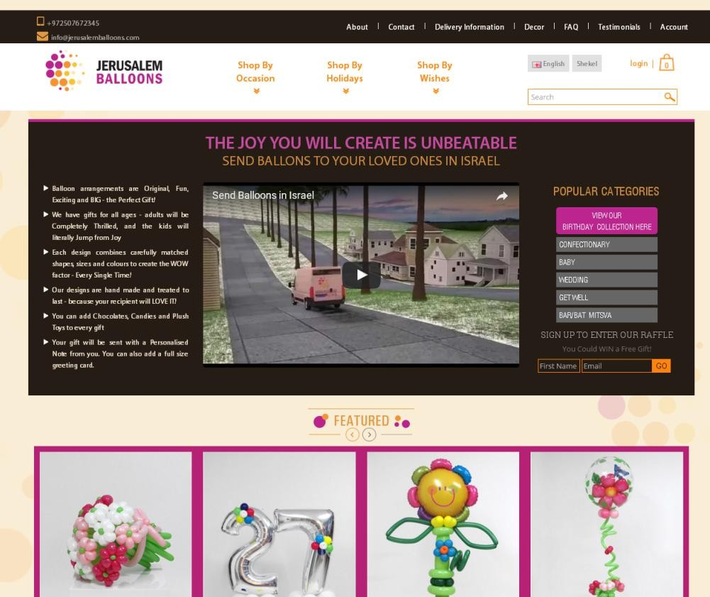
PPC Campaign – “Jerusalmballoons”
http://www.jerusalemballoons.com
Clicks: | 810
Impressions | 98,462
CTR | 0.82%
Conversions | 702
Conv. Rate | 104.00%
Campaign Overview
SN | Campaign | Budget | Impressions | Clicks | CTR | Avg. CPC
1 | Purim 2019 | 200.00 | 3287 | 244 | 7.42% | 4.81
2 | A2Z || Australia | 80.00 | 133 | 8 | 6.02% | 2.24
3 | A2Z || Asia | 50.00 | 3499 | 180 | 5.14% | 2.42
4 | A2Z || Europe | 120.00 | 879 | 39 | 4.44% | 1.83
5 | A2Z || Call-only | 50.00 | 56 | 2 | 3.57% | 0.86
6 | A2Z || American Cont. | 50.00 | 4834 | 155 | 3.21% | 2.59
7 | A2Z Campaign 1 | 30.00 | 28298 | 686 | 2.42% | 3.36
8 | A2Z || Africa | 80.00 | 597 | 14 | 2.35% | 1.72
9 | A2Z || Russia | 80.00 | 63 | 1 | 1.59% | 1.12
10 | Optimised Campaign 2 | 70.00 | 98462 | 810 | 0.82% | 2.96

Slide 5
PPC Campaign – “Slimplatesystem”
https://www.slimplatesystem.com
Clicks: | 1,254
Impressions | 246,465
CTR | 0.51%
Conversions | 179
Conv. Rate | 14.42%
Campaign Overview
SN | Campaign | Budget | Impressions | Clicks | CTR | Avg. CPC
1 | Slimplatesystem.com | 8.90 | 66 | 5 | 7.58% | 1.78
2 | Slimplatesystem.com | 7.09 | 187 | 11 | 5.88% | 0.64
3 | Test1 #2 | 0.29 | 22 | 1 | 4.55% | 0.29
4 | Slimplatesystem.com | 13.66 | 216 | 9 | 4.17% | 1.52
5 | Slimplatesystem.com | 0.94 | 26 | 1 | 3.85% | 0.94
6 | Slimplatesystem.com | 2.30 | 82 | 3 | 3.66% | 0.77
7 | Test1 #2 | 2.42 | 195 | 7 | 3.59% | 0.35
8 | Test1 | 2.04 | 184 | 6 | 3.26% | 0.34
9 | Slimplatesystem.com | 0.47 | 4 | 1 | 25.00% | 0.47
10 | Slimplatesystem.com | 0.95 | 10 | 2 | 20.00% | 0.48

Slide 6
THANK YOU!

